Slide 1


Guide to the neighborhoods of Düsseldorf
Oliver M.

Slide 2
Agenda
Introduction
Data Description
Exploratory Data Analysis
Modelling
Conclusion

Slide 3
Introduction
Düsseldorf …
… is the 7th largest city of Germany
… is one of the global top 10 cities worth living in
If you would like to move to Düsseldorf – Where would you like live within the city?
How many neighborhoods are there? Which neighborhood is offering what? Which are the most popular neighborhoods?
→ This project aims to provide a clustering of the different neighborhoods based on selected social and urban design specific indicator

Slide 4
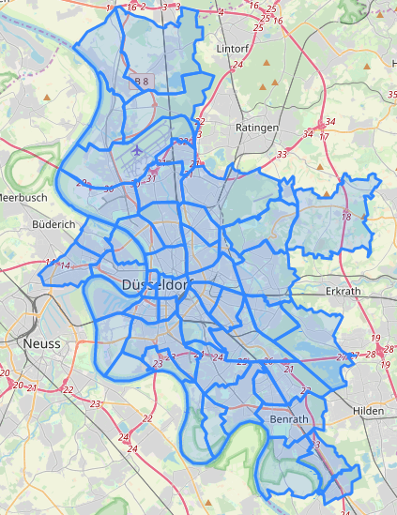
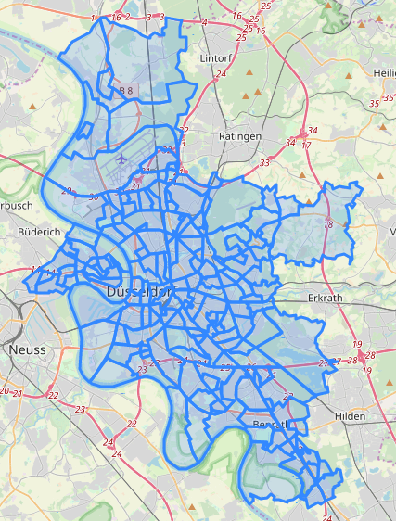
Structure
50 Neighborhoods
179 Social Areas

Slide 5
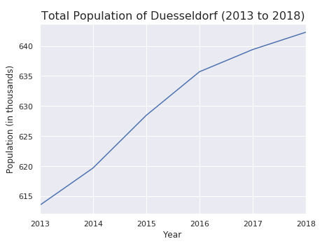
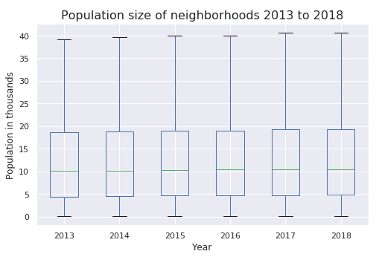
Population
Constant growth over the last five years
Total population increased from 614 thousand to 643 thousand (+4.7%)
Population per neighborhood between 1,000 and 40,000 residents

Slide 6
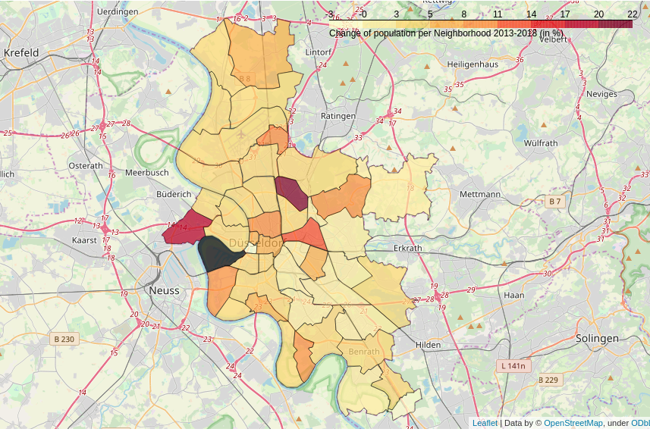
Most and least popular neighborhoods
Most popular:
Mörsenbroich
Flingern Nord
Heerdt
Least popular:
Hellerhof
Carlstadt
Assessment based on growth / reduction of population 2013 to 2018 and trend in last two years

Slide 7
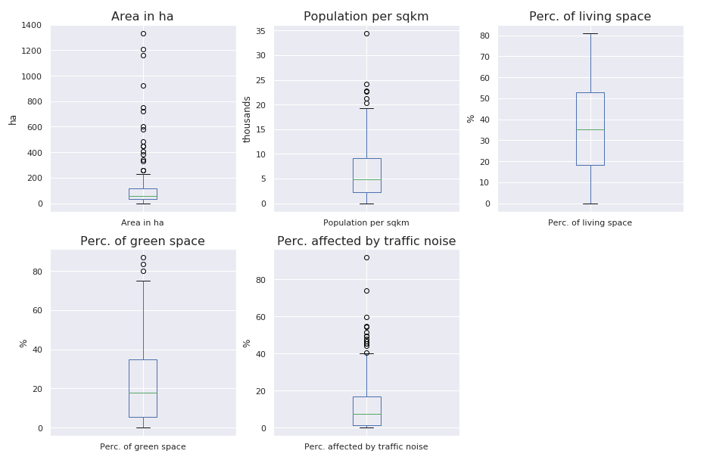
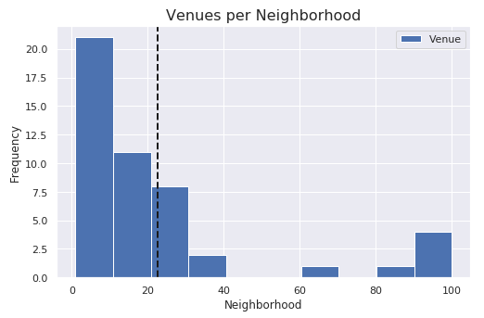
Social and Environmental Characteristics
Characteristics of Social Areas
Number of Venues
Lots of outliers in the different characteristics (features) of the social areas of Düsseldorf
Neighborhoods provide varying living experience and number activities

Slide 8
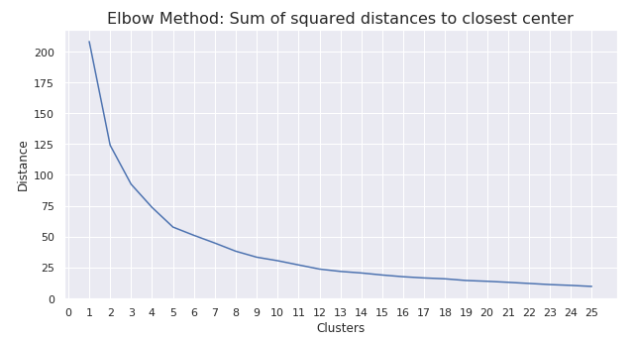
Clustering of Neighborhoods
Clustering of Neighborhoods according to KMeans Model
Elbow suggestes best fit with five clusters

Slide 9
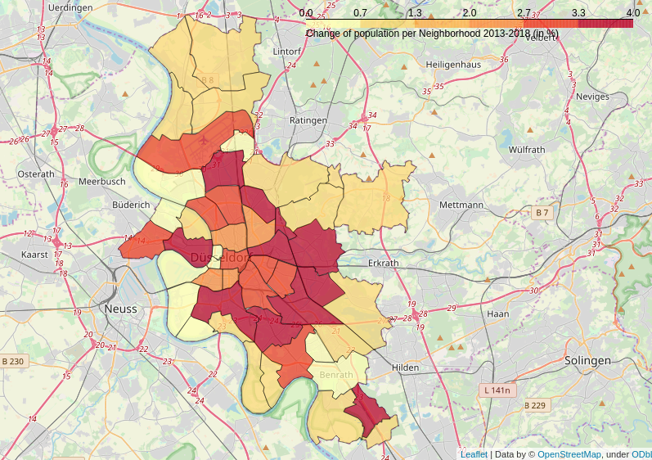
Neighborhood Clusters
Cluster | Description
0 | Assumably lots of stores, businesses and even industry, as living and green space only make for about 35% of the overall space. Top venues do include only very minor public / cultural sights.
1 | Very green with lots of green spaces, Beaches and Sport Areas. Only few venues for going out, such as bars or restaurants.
2 | Very crowded, most dense population per sqkm and highest share of living space. Lots of venues for Food & Drink and Bars.
3 | Very noisy and assumably lots of stores, businesses and Hotels.
4 | Around two thirds of area is made of living and green space, while medium density of population per sqkm. Potentially more spaceous houses and flats than in Cluster 2. Lots of venues for Food & Drink and Italian restaurants, but also natural sites.

Slide 10
Conclusion
Mörsenbroich and Flingern Nord, two of the three strongest growing neighorhoods of Düsseldorf are part of Cluster 4, providing a potentially interesting mix of living and green space. It will be interesting to see, how especially the percentage of green space will develop over time, as a growing population demands additional living spaces. Herdt being less crowded but stronger affected by traffic noise, is part of cluster 3.
Hellerhof, being the neighborhood with the strongest absolute decrease in population is part of Cluster 1, which might still be an interesting living area judging from the facts at hand: near to the city, but still green and very low traffic noises.

